Slide 1
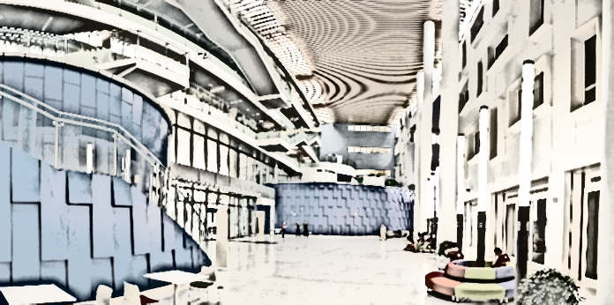
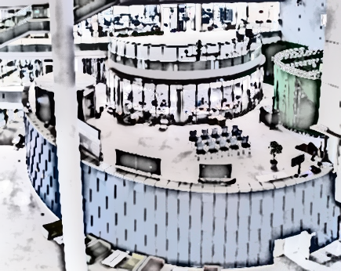

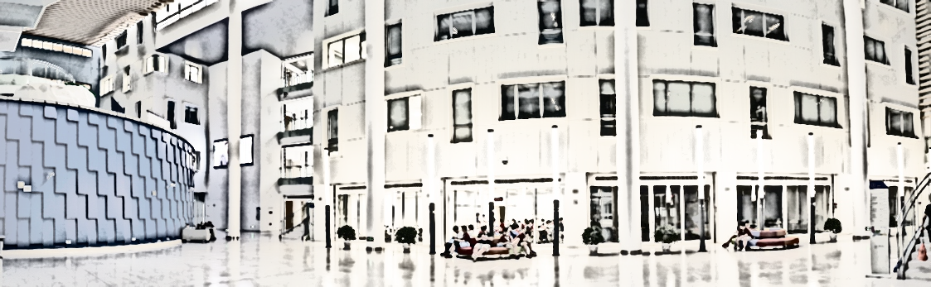
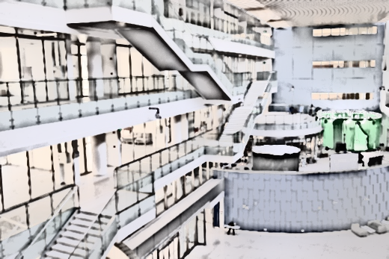
EE160: Introduction to Control Part II
Classic Control
Y. Wang
Office hour: Wednesday 2:00pm-3:00pm @ 1D201.E

Slide 2
OutLine
Take a break from all mathematical mess and look how our ancestors get us down to the place where we are…
01 Early control: 300 B.C. -1900s
02 Classical control : 1900s-1960s
03 Modern control : 1960s-now?
Notes:
What this course mainly focuses on is the third part

Slide 3
OutLine
Take a break from all mathematical mess and look how our ancestors get us down to the place where we are…
01 Early control: 300 B.C. -1900s
02 Classical control : 1900s-1960s
03 Modern control : 1960s-now?

Slide 4
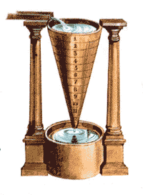
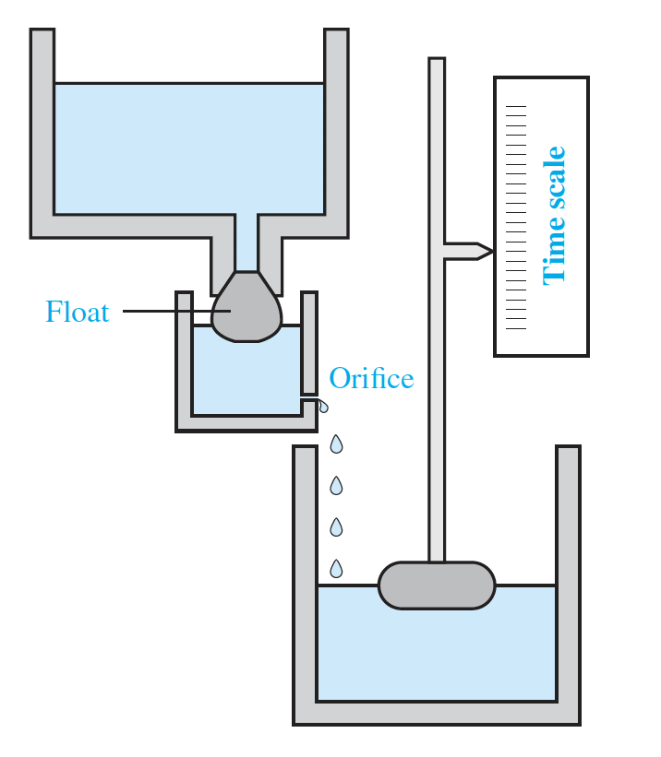
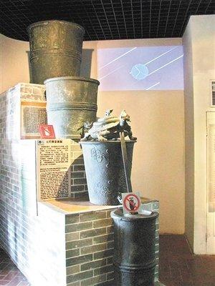
Early control
Where the story begins...
A long long time ago…
﻿Described by Vitruvius and attributed to Ktesibios (Greece? Middle East? Egypt?), was used until the 17th century.
Automatic
Ancient Rome：270 B.C.
Water Clock
Rites of Zhou: 770 B.C.
Notes:
亚历山大·克特西比乌斯:希腊人，在古埃及，理发师、发明家.据传他发现了空气的弹性，研制出几种使用压缩空气的器械，包括压水唧筒和以空气为动力的弩炮。最著名的一项发明是一种改良的滴漏计时器——水钟，以恒速滴落的水滴使一个带指针的浮子上升，借以指示时间的推移。克特西比乌斯的著述已经失传，他的发明是由于维特鲁威和希罗的援引始为世人所知。是古罗马作家、建筑师和工程师（约公元前50年到前26年间在军中服役，在军事服役过程中担任军事工程师和工程设备管理的首席执行官），活跃于公元前一世纪。尽管他建了一座长方形廊柱大厅式基督教堂，但是对他的关注更多是来自于他的著作——《建筑十书》——在建筑和历史上有重要地位。
漏壶由五个铜质壶组成，壶口间以龙头玉管向下滴水。正面三个敞口敛底方壶总称播水壶，自上而下依次为“日天壶”、“夜天壶”、“平水壶”。平水壶后面下侧有分水壶，平水壶前的圆筒为“受水壶”，三个铜壶稳定水压，

Slide 5

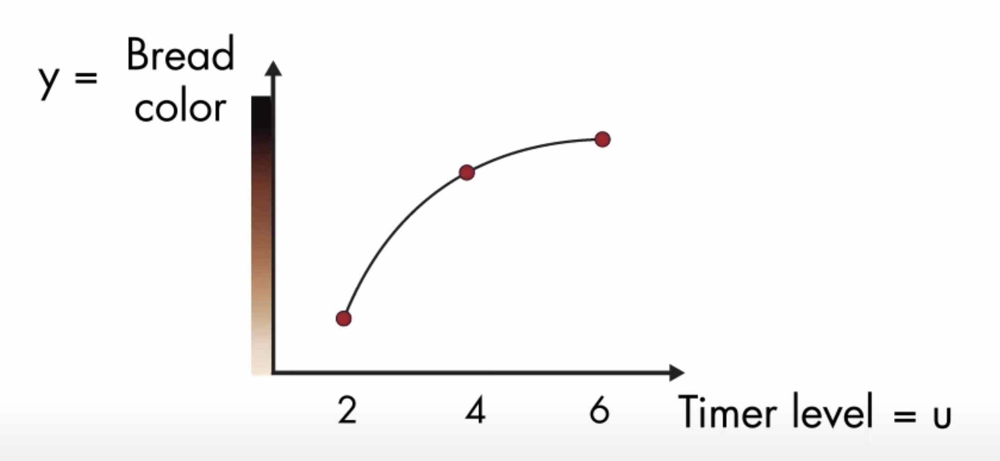
Early Control
What is a control system?
DEFINITION : Wherever there is a system that measures something, think about how to appropriately react based on the measurement, and then does something to a dynamic plant based on its though process, it is likely using a form of control.
Examples:
Automated vehicles
Social, economic, and political systems
UAVs
Humanoid robots
Electric power industry
Biomedical engineering
Open-loop Toaster
Toast based on Time (Plant model)
Problem: model change?
Notes:
We are not saying that open-loop sys is not a control system, we just emphasis the significance of feedback,
The idea of systematically study the control problem

Slide 6

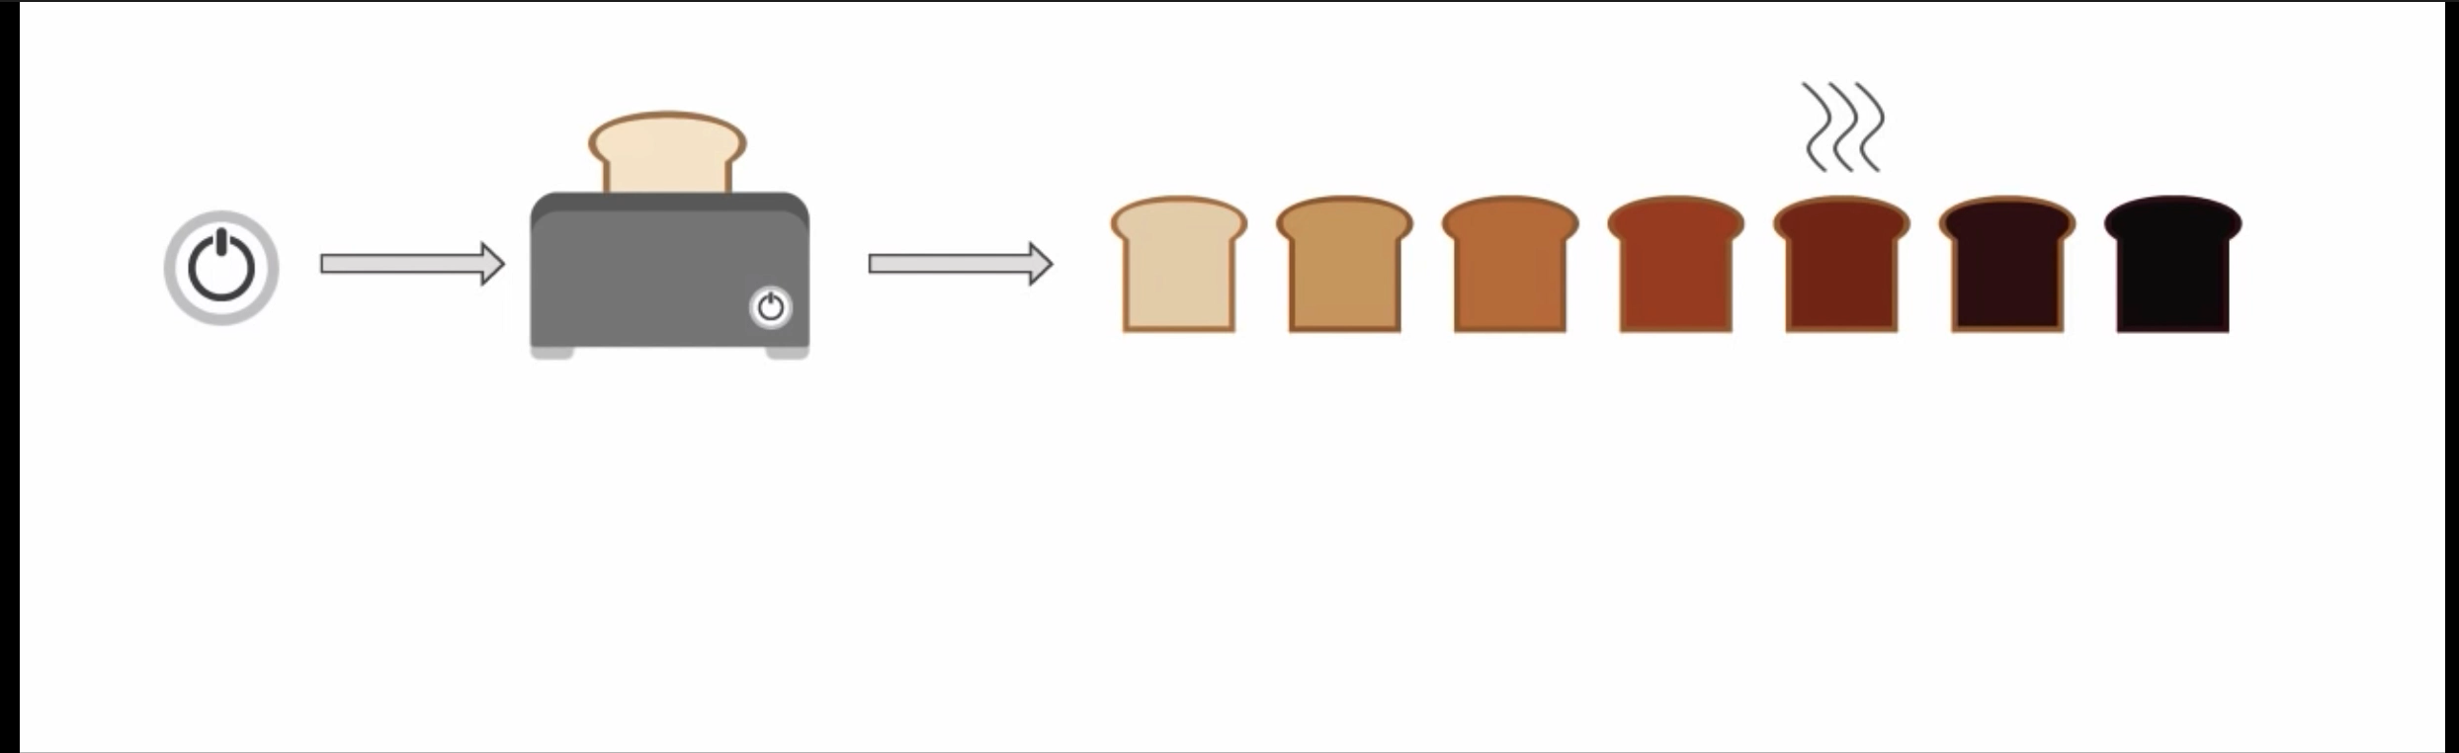
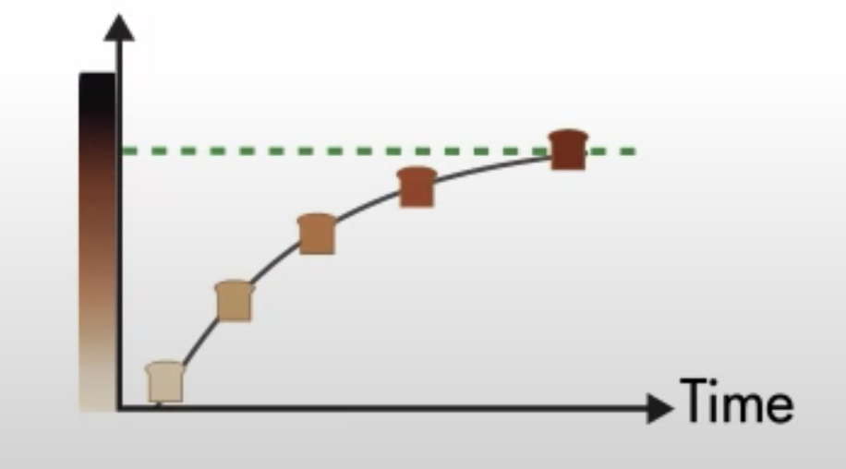
Early Control
Why feedback control system?
KEY FACTORS: Sense, Think and Do
Control system engineering is based on the foundations of
feedback theory
Closed-loop Toaster
Toast based on Color (Error)
Human being acting as sensor and controller (decision maker) for a long long time and most engineering applications, Until….
Notes:
We are not saying that open-loop sys is not a control system, we just emphasis the significance of feedback,
The idea of systematically study the control problem

Slide 7
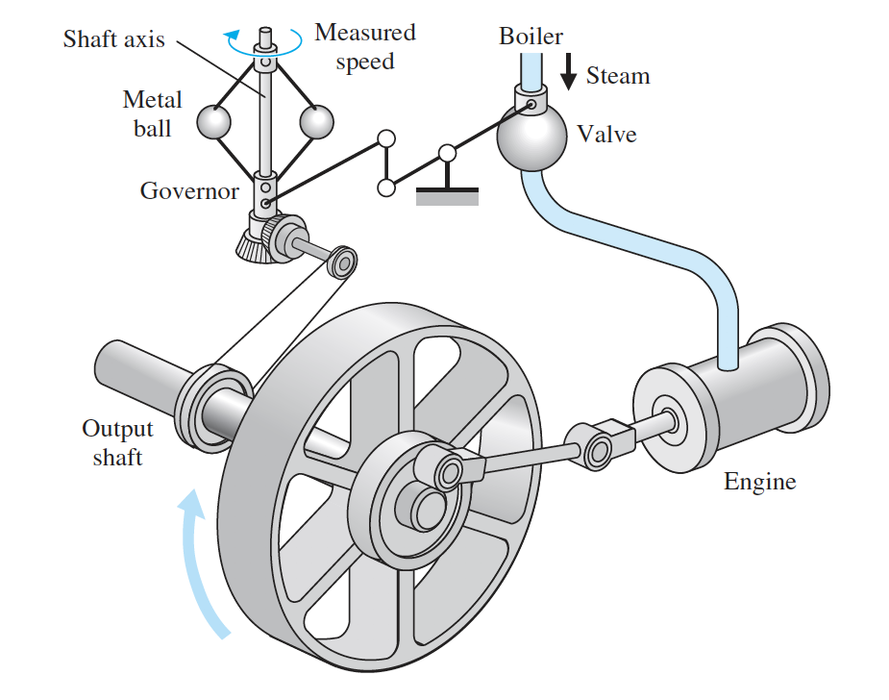
Early Control
18th century
1769 ：James Watt’s flyball governor
IF steam engine output shaft speed increases
the ball weights rise and move away from the shaft axis
the steam valve closes
the engine slows down
The first technically automatic feedback controller
Notes:
The first automatic feedback controller: the governor shaft axis is connected via mechanical linkages and beveled gears to the output shaft of the steam engine.
飞球调速器

Slide 8
Early Control
18th century
James Watt’s flyball governor in 1769
IF steam engine output shaft speed decreases
the ball weights fall and move close to the shaft axis
the steam valve opens
the engine speed up
The first technically automatic feedback controller
The first typical proportional controller
Notes:
The first automatic feedback controller: the governor shaft axis is connected via mechanical linkages and beveled gears to the output shaft of the steam engine.
Steady state 唯一

Slide 9
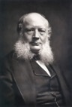
Early Control
19th century
James Watt’s flyball governor disadvantages:
﻿provided only proportional control and hence exact control of speed at only one operating condition
it could operate only over a small speed range;
it required careful maintenance
Improvements:
﻿William Siemens (1846) ：integral
﻿Charles T. Porter (1858)： ﻿higher speeds
﻿Thomas Pickering (1862) ：﻿spring-loaded governors
William Hartnell (1872)： ﻿smaller physical size
Mechanician
Notes:
19世纪后期德国科学家、企业家家族。他们发明的自励直流发电机和平炉炼钢法对电力工业和钢铁工业的发展有相当的影响，他们创建的西门子公司在20世纪成为世界著名电工制造企业。西门子家族的4 兄弟是E.沃纳·西门子、卡尔·威廉·西门子、卡尔·西门子和威廉·西门子。其中，以大哥、二哥最为著名。

Slide 10
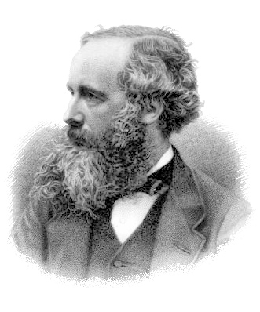
Early Control
19th century
Here goes the ﻿mathematicians and physicists:
Laplace 1785
Lagrange 1788
Fourier 1807
Cauchy 1825
J. C. Maxwell 1868 : “﻿On Governors”
formulated a mathematical theory related to control theory using a differential equation model of a governor
Notes:
Louis-François Cauchy was further promoted, and became Secretary-General of the Senate, working directly under Laplace (who is now better known for his work on mathematical physics). The famous mathematician Lagrange was also a friend of the Cauchy family

Slide 11
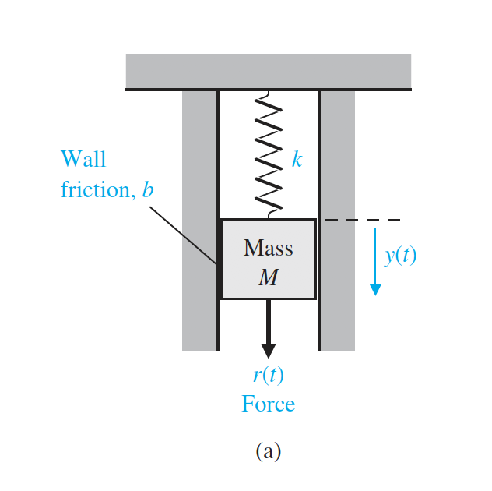
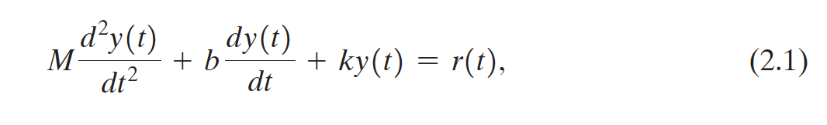
Early Control
19th century
Concepts start to emerge…
Modeling, Dynamic
Electrical
Current $i$,Capacity $C$,Voltage $v$…
Electrical
Current 𝑖,Capacity 𝐶,Voltage 𝑣…
Fluid
Volume, pressure…
Mechanical
Force, mass, velocity,
Position, friction…
Thermal
Temperature, Heat energy..
Differential equations
Utilizing Newton’s second law yields:
Next, I’m going to solving the equation…
。。。
Er, did you take your pills this morning?

Slide 12
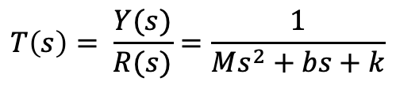
Early Control
19th century
Concepts start to emerge…
Modeling, Dynamic
Frequency domain, transfer function
$$e^{−at}→\frac{1}{s+a}$$
𝑒^(−𝑎𝑡)→1/(𝑠+𝑎)
$$\sin\left(ωt\right)→ \frac{ω}{s^{2}+ω^{2}}$$
sin⁡(𝜔𝑡)→ 𝜔/(𝑠^2+𝜔^2 )
$$\frac{d}{dt}→s$$
𝑑/𝑑𝑡→𝑠
$$1→ \frac{1}{s}$$
1→ 1/𝑠
Algebraic equations
Utilizing Newton’s second law yields:
Utilizing Laplace transform yields:
Transfer function:
$$T\left(s\right)= \frac{Y(s)}{R(s)}=\frac{1}{Ms^{2}+bs+k}$$
Notes:
that a system became unstable when the real part of a complex root became positive; the problem was how to determine the location of the real parts of the complex roots without finding the roots of the equation
Transfer function is a bit similar to the idea of fundamental solution

Slide 13
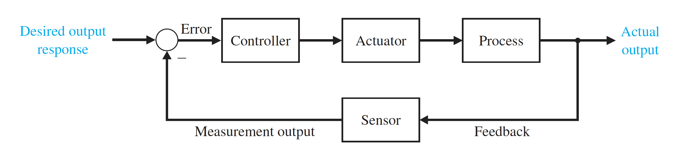

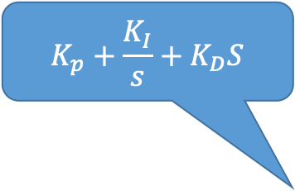

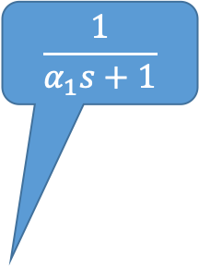
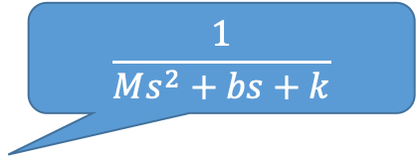
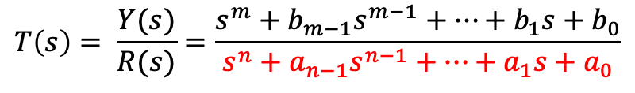
Early Control
19th century
Concepts start to emerge…
$$\frac{1}{α_{1}s+1}$$
Modeling, Dynamics , Differential equation
Frequency domain, transfer function
Block diagram
$$K_{p}+\frac{K_{I}}{s}+K_{D}S$$
$$\frac{1}{Ms^{2}+bs+k}$$
$$K$$
Characteristic equation and Stability
$$T\left(s\right)= \frac{Y(s)}{R(s)}=\frac{s^{m}+{b_{m−1}s}^{m−1}+…+b_{1}s+b_{0}}{s^{n}+{a_{n−1}s}^{n−1}+…+a_{1}s+a_{0}}$$
a system became unstable when the real part of a complex root became positive
Notes:
that a system became unstable when the real part of a complex root became positive; the problem was how to determine the location of the real parts of the complex roots without finding the roots of the equation

Slide 14
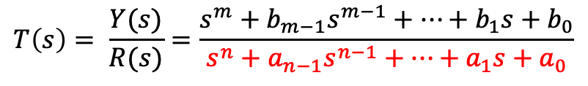
Early Control
19th century
Concepts start to emerge…
Modeling, Dynamics , Differential equation
Frequency domain, transfer function
Block diagram
Characteristic equation and Stability
$$T\left(s\right)= \frac{Y(s)}{R(s)}=\frac{s^{m}+{b_{m−1}s}^{m−1}+…+b_{1}s+b_{0}}{s^{n}+{a_{n−1}s}^{n−1}+…+a_{1}s+a_{0}}$$
the problem was: how to determine the location of the real parts of the complex roots without finding the roots of the equation?
﻿1895 R-H criterion
Edward J. Routh and the Swiss mathematician Adolf Hurwitz derived the criteria independently

Slide 15
OutLine
Take a break from all mathematical mess and look how our ancestors get us down to the place where we are…
01 Early control: 300 B.C. -1900s
02 Classical control : 1900s-1960s
03 Modern control : 1960s-now?
Notes:
﻿Most of the inventions and applications of this period were concerned with the basic activities of controlling temperatures, pressures, liquid levels, and the speed of rotating machinery: the desire was for regulation and for stability
Main motivation comes from 民生科技，出现了伺服控制这样的词汇

Slide 16

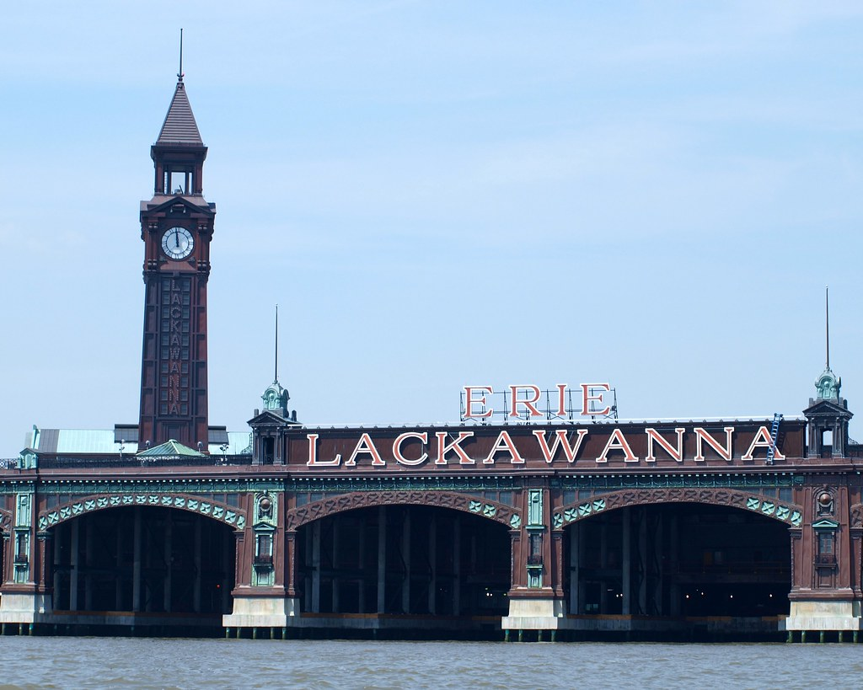
Classical control
World war period
Here comes the power of Money and Government…
﻿1909 - 1929﻿ sales of sensors and controller
AT&T， Siemens， IBM…
1927, Harold S. Black from Bell Laboratories sketched a circuit for a negative feedback amplifier
Then came the morning of Tuesday, August 2, 1927, when the concept of the negative feedback amplifier came to me in a flash while I was crossing the Hudson River on the Lackawanna Ferry, on my way to work.
Lackawanna Clock Tower, Hoboken Terminal,
Hudson River, NY, New Jersey
Notes:
The IBM divisions manufactured a wide range of products, including employee time-keeping systems, weighing scales, automatic meat slicers, coffee grinders, and punched card equipment.
﻿The word "feedback" is a 20th century neologism introduced in the 1920s by radio engineers to describe parasitic, positive feeding back of the signal from the output of an amplifier to the input circuit. It has entered into common usage in the English-speaking world during the latter half of the century.

Slide 17
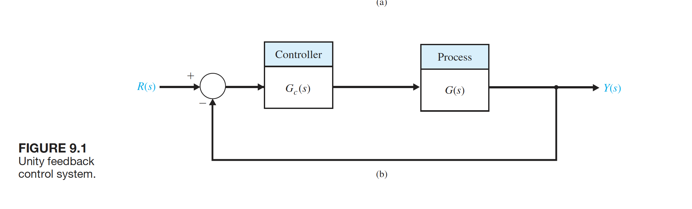
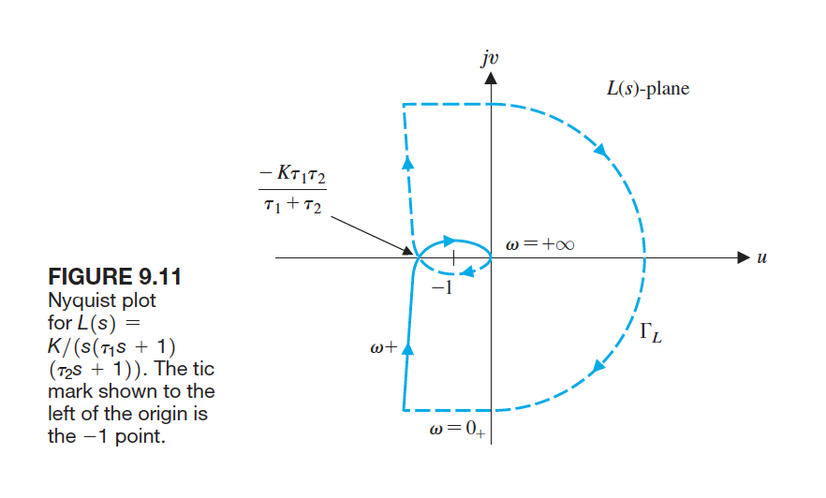
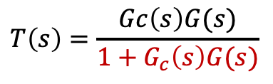
Classical control
World war period
Here comes the power of Money and Government…
﻿1909 - 1929﻿ sales of sensors and controller
AT&T， Siemens， IBM…
1927, Harold S. Black from Bell Laboratories sketched a circuit for a negative feedback amplifier
1932, Harry Nyquist
Nyquist Plot, Nyquist criterion: Still for STABILITY!
Unity Feedback System
Investigate the characteristic equation of the system:
$$T\left(s\right)=\frac{Gc\left(s\right)G(s)}{1+G_{c}\left(s\right)G(s)}$$
Notes:
A frequency domain stability criterion was developed by H. Nyquist in 1932,
and it remains a fundamental approach to the investigation of the stability of
linear control systems [1, 2]. The Nyquist stability criterion is based on a theorem
in the theory of the function of a complex variable due to Cauchy. Cauchy’s theorem
is concerned with mapping contours in the complex s-plane, and fortunately
the theorem can be understood without a formal proof requiring complex variable
theory.
A simple example Gc(s) = ks/s+1 G(s)= 1/s+2 k>-3

Slide 18
Classical control
World war period
Here comes the power of Money and Government…
﻿1909 - 1929﻿ sales of sensors and controller
AT&T， Siemens， IBM…
1927, Harold S. Black from Bell Laboratories sketched a circuit for a negative feedback amplifier
1932, Harry Nyquist
﻿1936, Industrial Instruments and Regulators Committee
﻿1940, Hendrik Bode: Bode diagram
﻿1942, J.G. Ziegler and N.B. Nichols : ﻿Ziegler-Nichols tuning rules.
Notes:
Prior to 1940, for most cases, the design of control systems
was an art involving a trial-and-error approach. During the 1940s, mathematical and
analytical methods increased in number and utility, and control engineering became
an engineering discipline in its own right
A large impetus to the theory and practice of automatic control occurred during
World War II when it became necessary to design and construct automatic airplane
piloting, gun-positioning systems, radar antenna control systems, and other military
systems based on the feedback control approach

Slide 19
Classical control
World war period
Here comes the power of Money and Government…
﻿1909 - 1929﻿ sales of sensors and controller
AT&T， Siemens， IBM…
1927, Harold S. Black from Bell Laboratories sketched a circuit for a negative feedback amplifier
1932, Harry Nyquist
﻿1936, Industrial Instruments and Regulators Committee
﻿1940, Hendrik Bode: Bode diagram
﻿1942, J.G. Ziegler and N.B. Nichols : ﻿Ziegler-Nichols tuning rules.
1943, Invention of anti-aircraft guns
Two many names but a few organizations : MIT-EE, Bell Lab, MIT-Radiation Lab
Big news is Time domain analysis starts to wake up!
Notes:
1940, a control system problem was the creation of a gun director by David B. Parkinson of Bell Telephone Laboratories
﻿This is a complex problem that involves the detection of the position of the airplane, calculation of its future position, and the precise control of the movement of a heavy gun. The operation required up to 14 people to carry out complicated observation and tracking tasks in a coordinated way. The design of an adequate servomechanism to control the gun position was a ditfficult task.
﻿Work on this "systems" problem brought together mechanical, electrical, and electronic engineers, and an outcome of this cross-fertilization of ideas was a recognition that neither the frequency response approach used by the communication engineers nor the time domain approach favored by the mechanical engineers were, separately, effective design approaches for servomechanisms. What was required was an approach that used the best features of each

Slide 20
Classical control
World war period
Here comes the power of Money and Government…
﻿1909 - 1929﻿ sales of sensors and controller
AT&T， Siemens， IBM…
1927, Harold S. Black from Bell Laboratories sketched a circuit for a negative feedback amplifier
1932, Harry Nyquist
﻿1936, Industrial Instruments and Regulators Committee
﻿1940, Hendrik Bode: Bode diagram
﻿1942, J.G. Ziegler and N.B. Nichols : ﻿Ziegler-Nichols tuning rules.
1943, Invention of antiaircraft guns
1948, ﻿Walter Evans : Root Locus!
Classical control technique established!
Notes:
﻿By the end of the war the classical control techniques-with the exception of the root locus design method of Walter Evans (1948, 1 950)-had been established.
The design methodologies were for linear single-input systems-that is, systems that can be described by linear differential equations with constant coeffficient and that have a single control input. The frequency response techniques, based on the use of Nyquist, Bode, Nichols, and Inverse Nyquist charts, assessed performance in terms of bandwidth, resonance, and gain and phase margins and provided a graphical, pictorial view of the system behavior. The alternative approach based on the solution of the ditlcrential equations using Laplace transform techniques expressed performance in terms of rise time, percentage overshoot, steady-state error, and damping. Many cngineers preferred the latter approach because the pcr? formance was expressed in "real" terms, that is, the time behavior of the system. The disadvantage, of course, is that until the development of the root !locus method there was no simple and easy way in which the designer could relale parameter changes to time behavior changes.

Slide 21
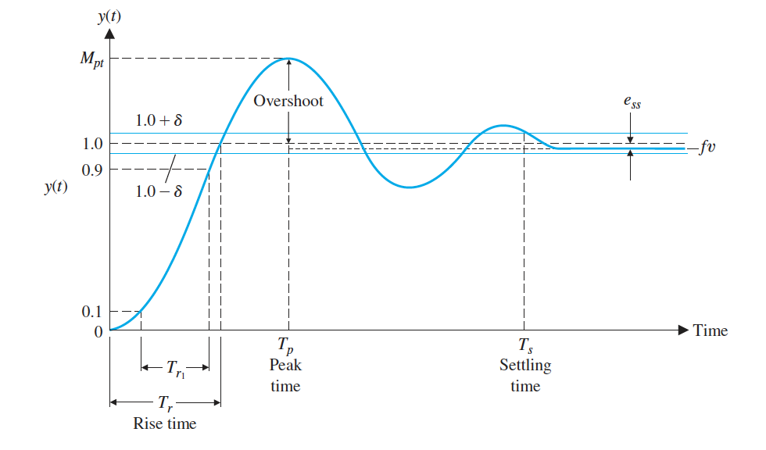
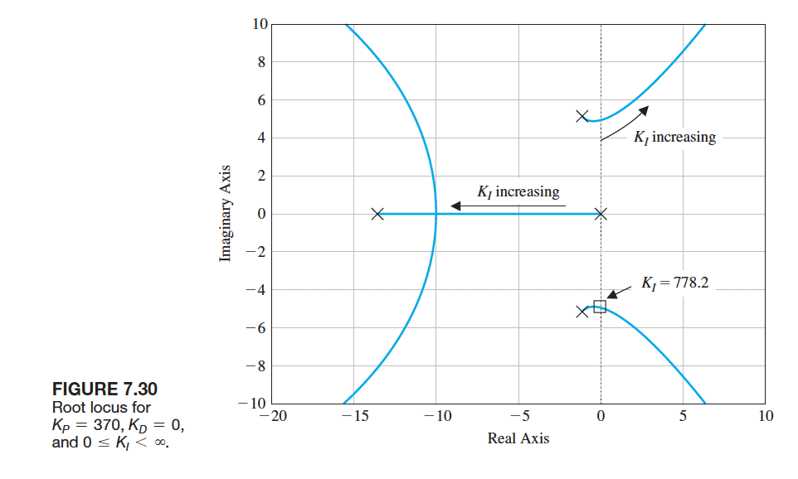
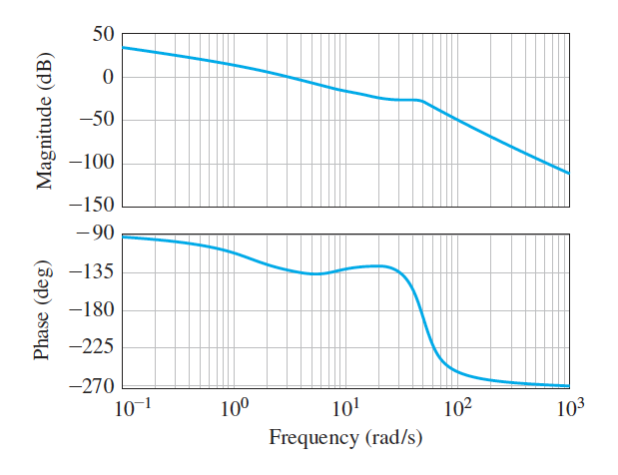
Classical control
World war period
What do we have…
frequency response
Routh-Hurwitz Nyquist Bode Nichols Root locus … | bandwidth cut frequency gain margin phase margins Poles & Zeros Stability …
time response
Laplace inverse differential equation | rise time, percentage overshoot steady-state error damping
A link needed
Notes:
﻿By the end of the war the classical control techniques-with the exception of the root locus design method of Walter Evans (1948, 1 950)-had been established.
The design methodologies were for linear single-input systems-that is, systems that can be described by linear differential equations with constant coeffficient and that have a single control input. The frequency response techniques, based on the use of Nyquist, Bode, Nichols, and Inverse Nyquist charts, assessed performance in terms of bandwidth, resonance, and gain and phase margins and provided a graphical, pictorial view of the system behavior. The alternative approach based on the solution of the ditlcrential equations using Laplace transform techniques expressed performance in terms of rise time, percentage overshoot, steady-state error, and damping. Many cngineers preferred the latter approach because the pcr? formance was expressed in "real" terms, that is, the time behavior of the system. The disadvantage, of course, is that until the development of the root !locus method there was no simple and easy way in which the designer could relale parameter changes to time behavior changes.

Slide 22
Classical control
World war period
What do we have…
frequency response
Routh-Hurwitz Nyquist Bode Nichols Root locus … | bandwidth cut frequency gain margin phase margins Poles & Zeros Stability …
time response
differential equation | rise time, percentage overshoot steady-state error damping
State Space!
A link needed
Notes:
﻿By the end of the war the classical control techniques-with the exception of the root locus design method of Walter Evans (1948, 1 950)-had been established.
The design methodologies were for linear single-input systems-that is, systems that can be described by linear differential equations with constant coeffficient and that have a single control input. The frequency response techniques, based on the use of Nyquist, Bode, Nichols, and Inverse Nyquist charts, assessed performance in terms of bandwidth, resonance, and gain and phase margins and provided a graphical, pictorial view of the system behavior. The alternative approach based on the solution of the ditlcrential equations using Laplace transform techniques expressed performance in terms of rise time, percentage overshoot, steady-state error, and damping. Many cngineers preferred the latter approach because the pcr? formance was expressed in "real" terms, that is, the time behavior of the system. The disadvantage, of course, is that until the development of the root !locus method there was no simple and easy way in which the designer could relale parameter changes to time behavior changes.

Slide 23
OutLine
Take a break from all mathematical mess and look how our ancestors get us down to the place where we are…
01 Early control: 300 B.C. -1900s
02 Classical control : 1900s-1960s
03 Modern control : 1960s-now?

Slide 24
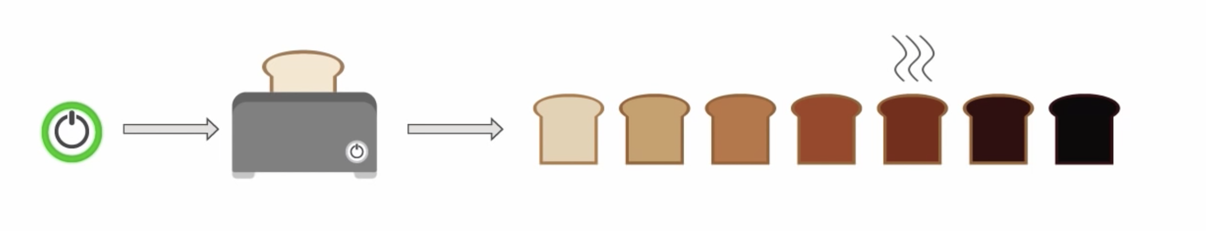
Modern control
Cold war period
Warning ：computer scientists are watching you.
1960s Kalman: State-space approach
Later on
Digital and discrete-time control Nonlinear control
Model predictive control Robust control Adaptive control NN based control Sliding-mode control Fuzzy control
… … …
The control community grow so fast and gets out of control.
Future
Smarter : AI
Interconnection
Integrated
…
Recall your toaster
Know your taste preference after a while? ML
Guess your taste preference based on your …? Big data
Upload your preference to the cloud? IoT
Judge your health condition and mood based on todays’ choice? AI
…
Notes:
﻿was largely determined by two factors: first, the problem that governments saw as important. the launching, maneuvering, guidance, and tracking of missiles and space vehicles;
and second, by the advent of the digital computer.

Slide 25
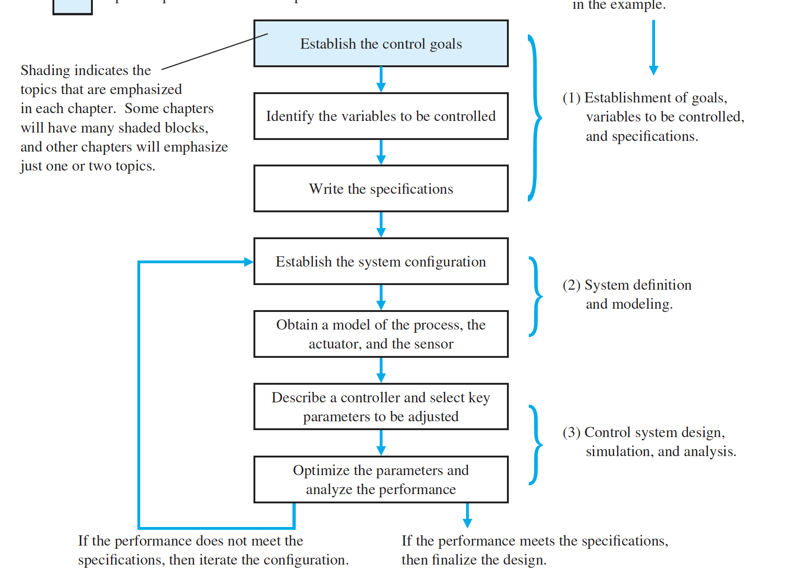
Modern control
Cold war period
The control system design process
Knowing what you want, might be more difficult than you think
CTO
Data analyst &
engineers in various fields
Here we are…
Notes:
合久必分，分久必合
IF you are a control expert, you tell them, control is everywhere, no engineering topic can leave without control
If you are not and you are encoutered with a control expert you don’t like, control itself does not exist

Slide 26
Try to smile and Let us go back to math.
Main References:
MathWork, Tutorial on control
Bennett, S. (2000). A Brief History of Automatic Control, 44(June 1996), 17–25.
Han, J. (2009). From PID to active disturbance rejection control. In IEEE Transactions on Industrial Electronics (Vol. 56, pp. 900–906).
Dorf, Richard C., Bishop, Robert H., Modern control systems, 2005 by Pearson Education, Inc., Hoboken, New Jersey
Aëšström, K. J., & Kumar, P. R. (2014). Control: A perspective. Automatica, 50(1), 3–43.
Wikipedia

Slide 27
Project
One goal:
The EE160 Project is about the modeling, simulation, and control of a nonlinear system of your choice.
Two options:
1. Pick at least one of the application examples we recommended
2. Propose a control problem of your own choice.
Three tasks:
1. Proposal report (with reference, deadline: Nov 25):
form your team (<=3) and roughly break down the task
modeling and define control objective,
linearize your system and do open-loop simulation
2. Project report (with introduction, deadline: Dec.25)
design your control law and brief analysis
verify effectiveness of your control law
check the robustness of your algorithm
3. Presentation (with live simulation demonstrate : Dec.23 or 25)
problem formulation
solution
live simulation demonstration( play with tuning parameters)

Slide 28

Thanks!

